Slide 1

RunVenture Fitness (Run) Tracker
(Based on MapMyRun.com)

Slide 2
What is it?
RunVenture is a fitness tracker app designed to provide runners with a smarter, more personalized training experience.
The app goes beyond basic run tracking by introducing:
Personalized Training Plans, which adapt to users’ goals, fitness levels, and past performance to ensure continuous improvement.
Social Challenges enhance motivation by allowing users to compete with friends and join community challenges.
Music and Podcast Integration brings seamless audio controls into the workout interface, eliminating the need to switch between apps mid-run.
After each session, Post-Run Insights provide actionable feedback, including hydration reminders, stretching guides, and recovery recommendations.
Lastly, Route Conditions give runners a detailed view of their chosen path, displaying surface types, elevation changes, and real-time congestion levels.

Slide 3
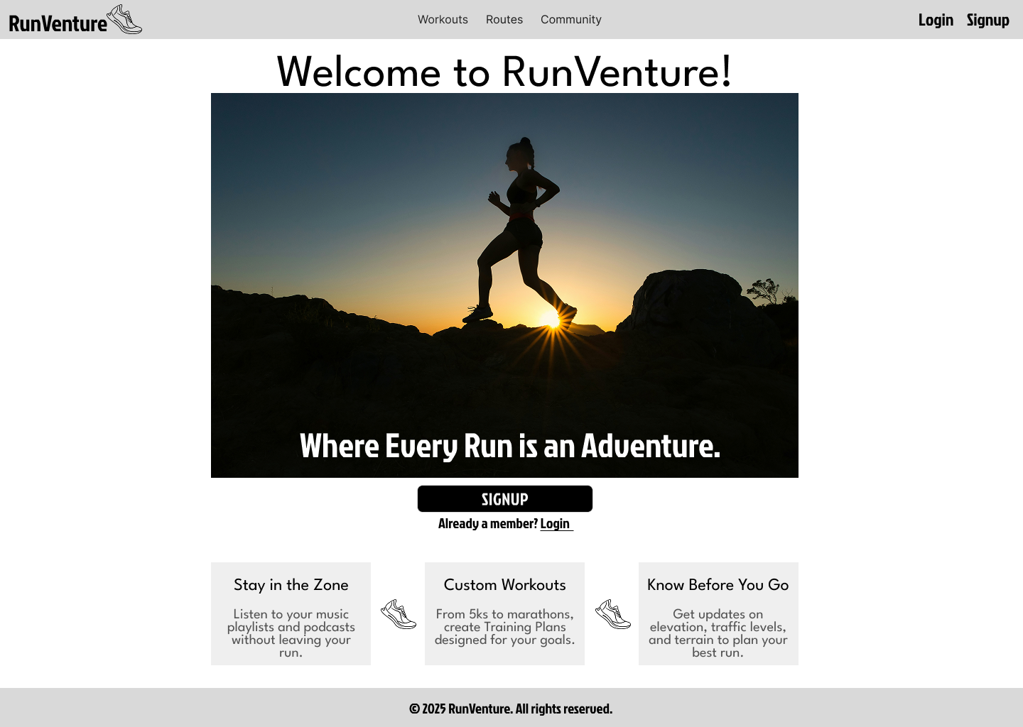
Homepage

Slide 4
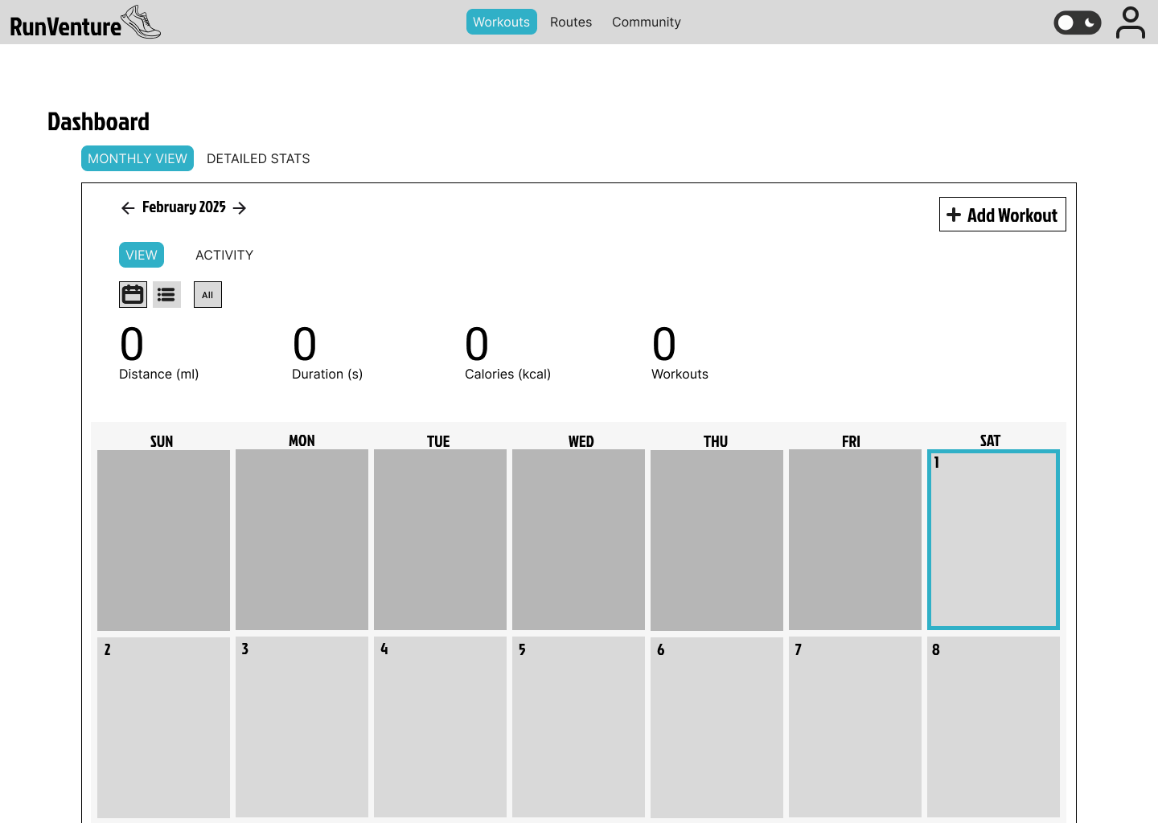
Dashboard (After User Logs In)

Slide 5
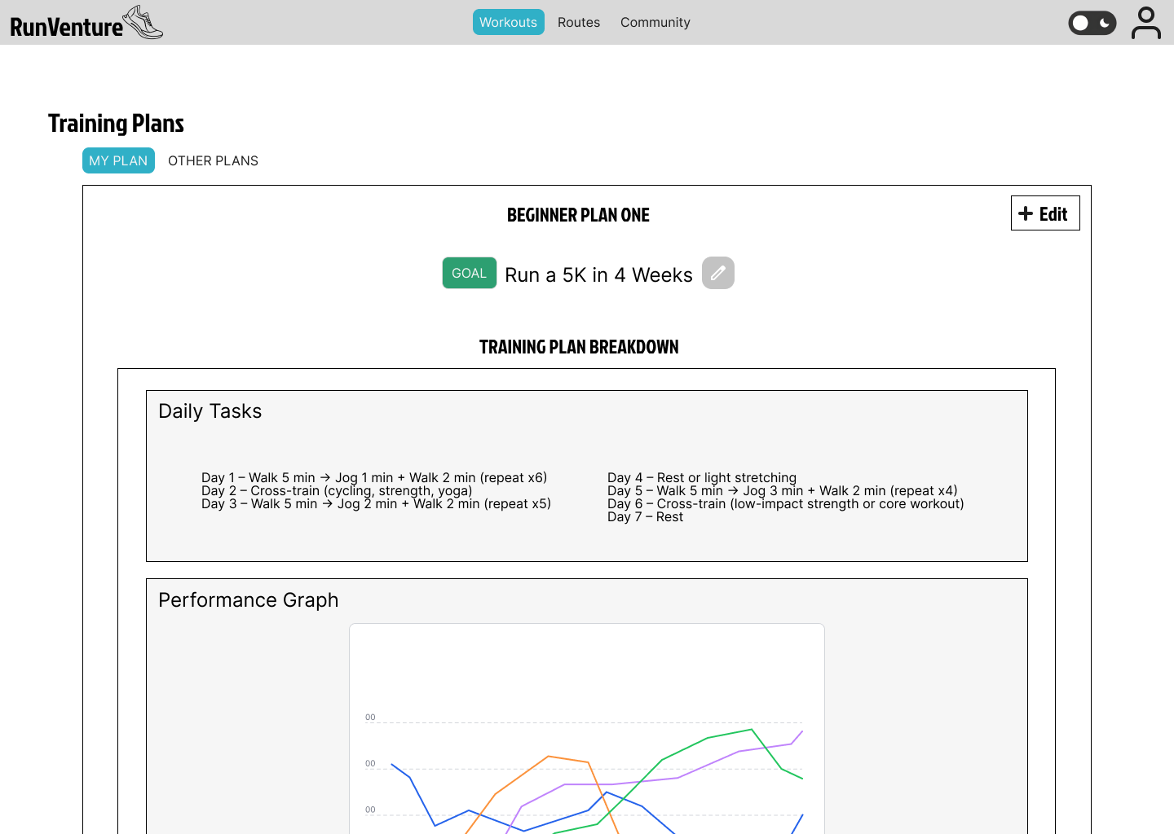
Personalized Training Plans
Current State: The app provides generic tracking, but lacks structured training programs.
Proposed Enhancement: Users receive tailored training plans based on goals, fitness levels, and past performance.
User Story: “As a user, I want a training plan tailored to my fitness goals, so I can improve my performance efficiently.”

Slide 6
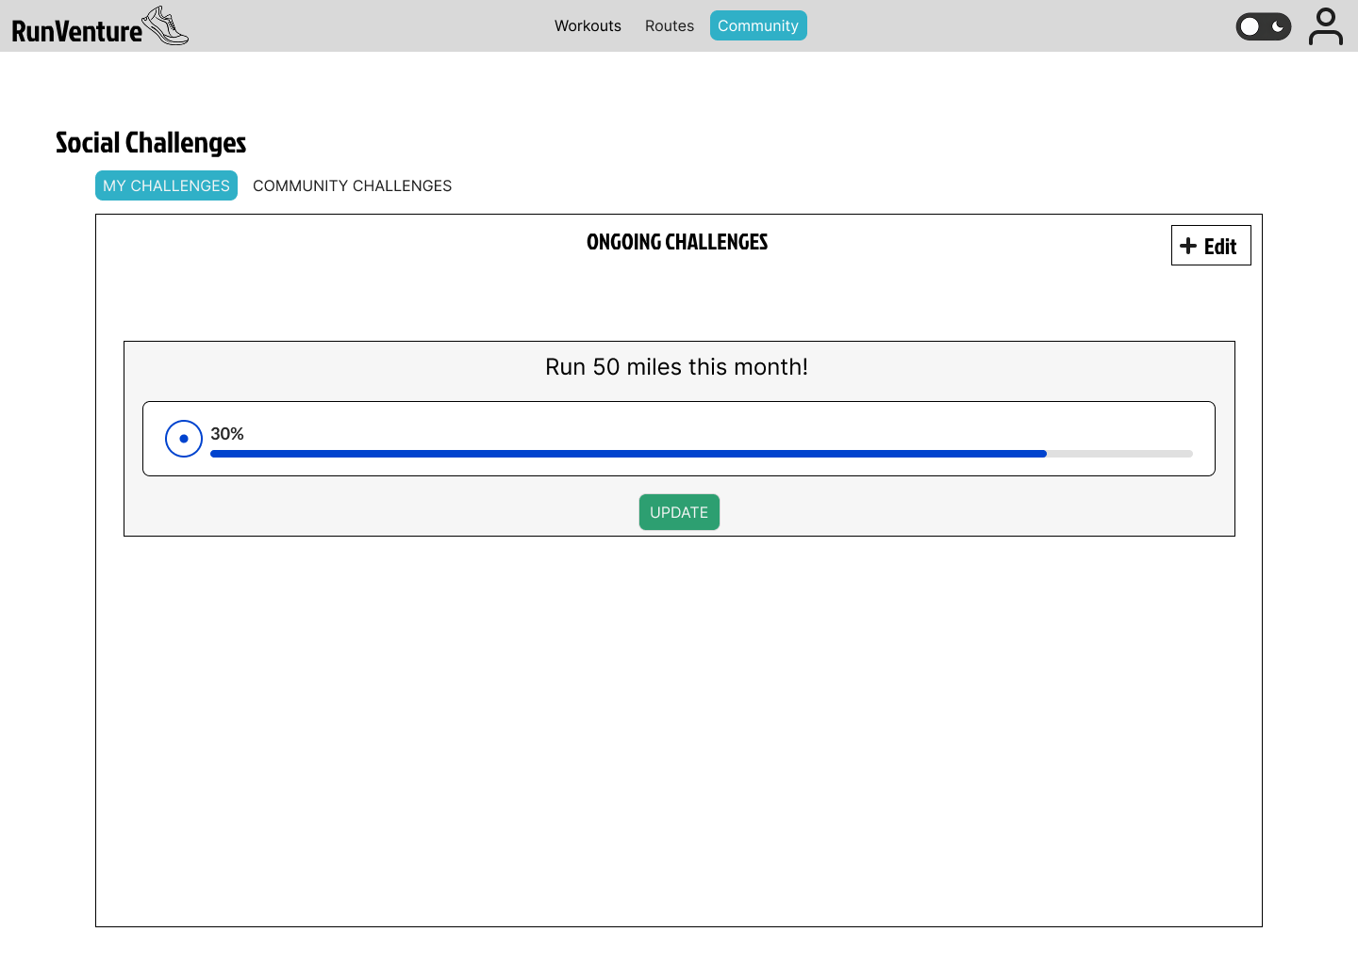
Social Challenges
Current State: Limited social engagement features.
Proposed Enhancement: Users can participate in challenges with friends or join community-based challenges to compete and stay motivated.
User Story: “As a user, I want to participate in challenges with my friends to stay motivated and improve my performance.”

Slide 7
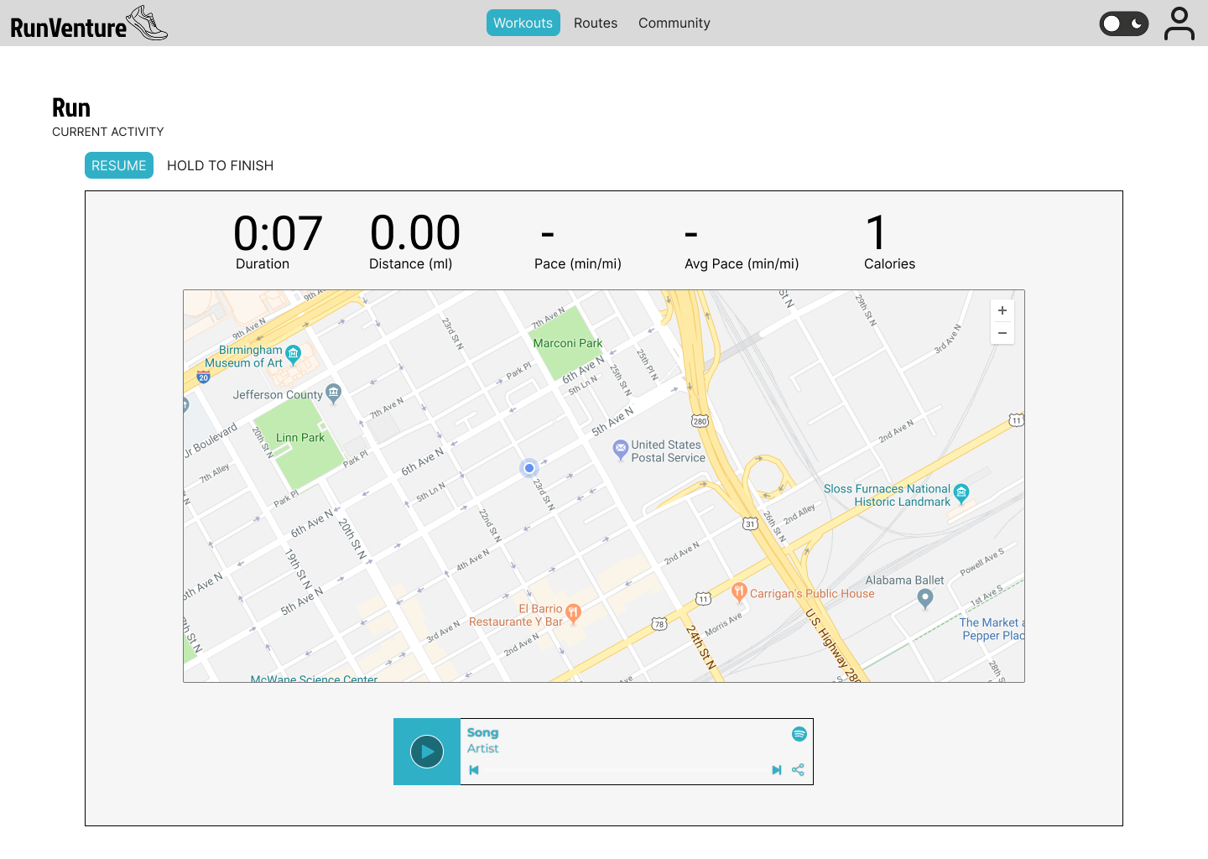
Music and Podcast Integration
Current State: Users must switch between external apps for music and podcast playback.
Proposed Enhancement: In-app music and podcast controls embedded within the workout screen, allowing for seamless playback without leaving the app.
User Story: “As a user, I want to control my music and podcasts within the workout app, so I don’t have to switch between apps during a run.”

Slide 8
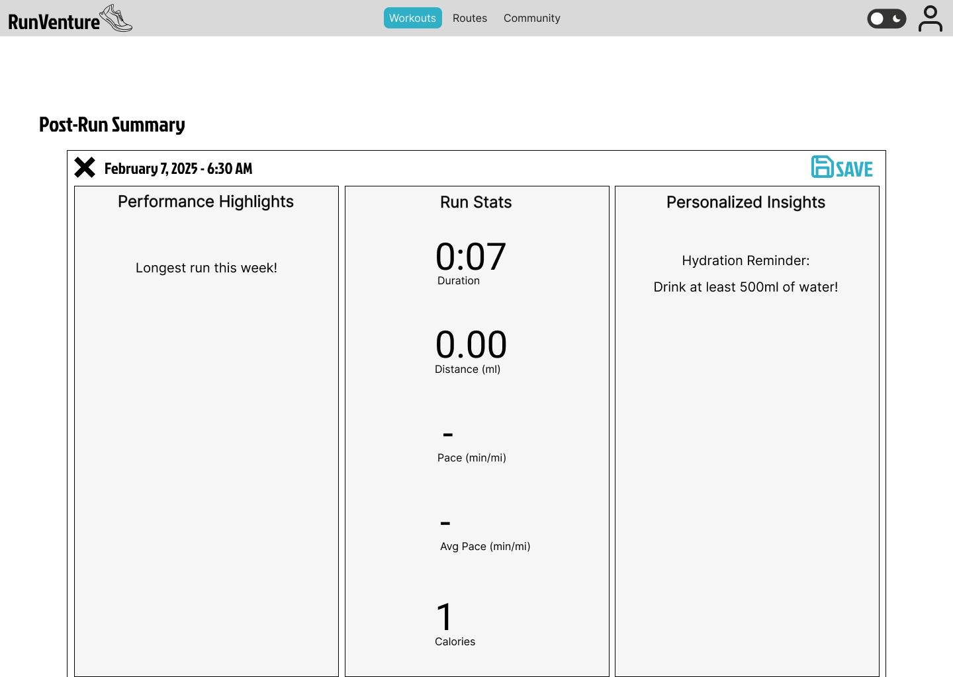
Post-Run Insights
Current State: Basic workout summaries are provided, but users receive minimal feedback on recovery or performance optimization.
Proposed Enhancement: The app provides smart post-run insights, including hydration reminders, stretching guides, and recovery recommendations based on workout intensity.
User Story: “As a user, I want personalized post-run insights so that I can recover properly and improve my training over time.”

Slide 9
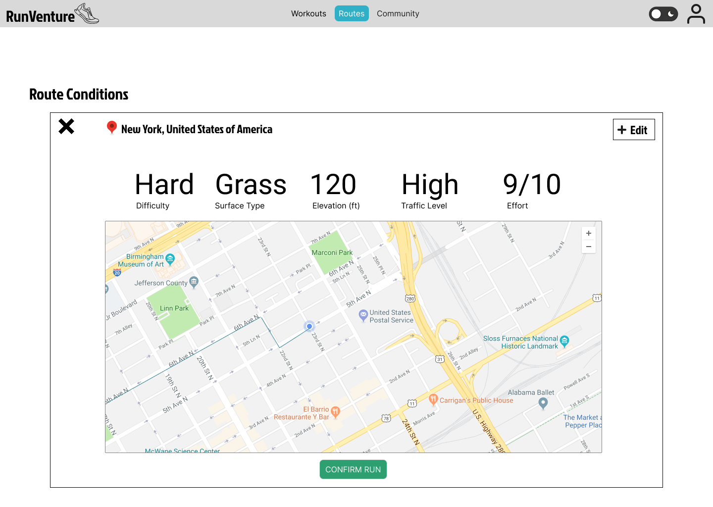
Route Conditions
Current State: Users can track routes, but lack insights on terrain, elevation, or real-time conditions.
Proposed Enhancement: The app displays route conditions before a workout, including surface type, elevation changes, and real-time congestion levels.
User Story: “As a user, I want to know the conditions of my running route before I start, so I can choose the best path for my workout.”

Slide 10
Thank you!

